Slide 1
Delivery System
Mohammed Asif | Imraan Boukarfi | Angie Berrio

Slide 2
Introduction
With threats like Covid-19 food delivery systems have become a necessity to the functioning of society
But an issues that universities face is that they don’t want a steady influx of visitors that may or may not pose a threat to the university
As such we have come up with a food delivery system for universities which is more secure and safe than traditional delivery services
The food delivery system intends to provide a system that universities and students alike can enjoy.
A university who purchases a food delivery system license can run it on their own and distribute the app to students.
This will allow the university to have control over and be able to approve any establishment and or driver that wants to deliver food on the campus.

Slide 3
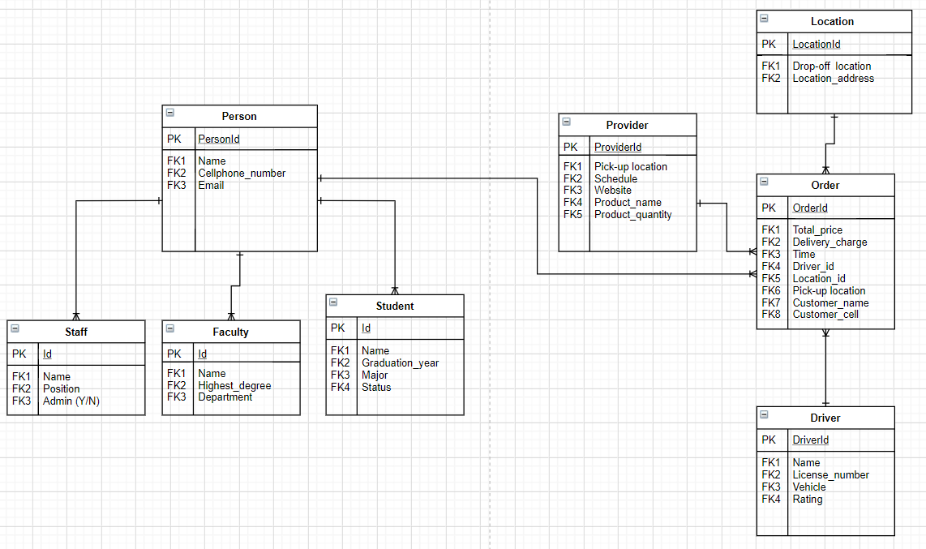
EER Diagram

Slide 4
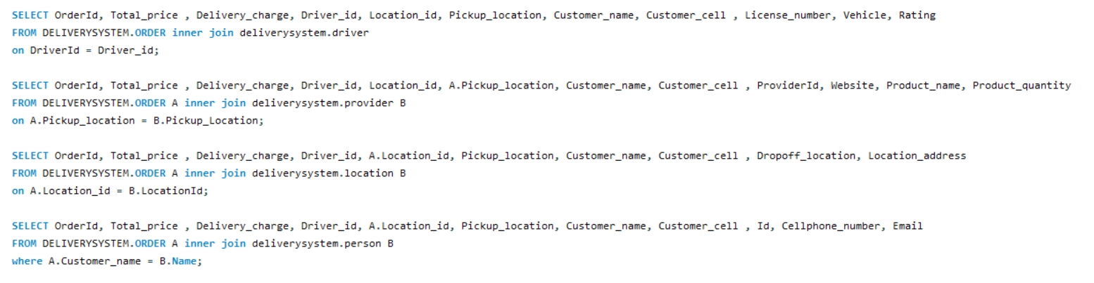
Queries
The below queries are join statements that connect “Person”, “Provider”, “Location” and “Driver” to “Order”

Slide 5
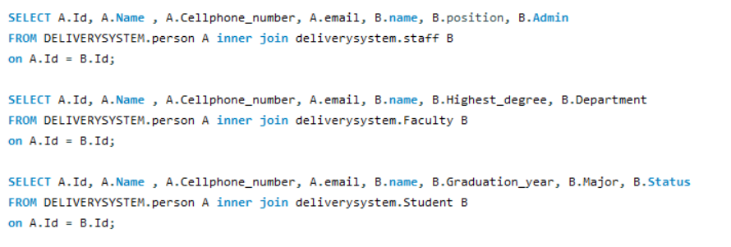
Queries (cont.)
The below queries are join statements that connect “Staff” “Faculty” and “Student” to “Person”

Slide 6
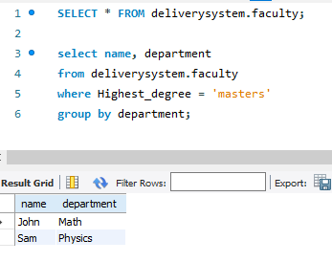
Queries (group-by)
The below query is an “group-by” statement that looks at highest degree earned from a pool of people and groups by the department

Slide 7
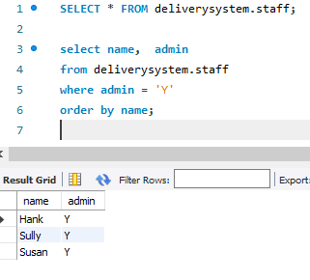
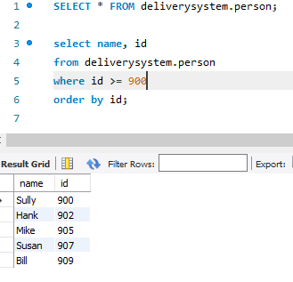
Queries (order-by)
The below queries are “order-by” statements that one, looks at id numbers 900 or higher and orders them in ascending order
The second on looks at the admins and orders them by name alphabetically

Slide 8
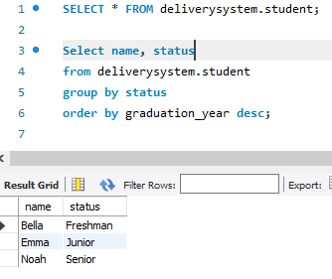
Queries (Order-by & Group-by)
The below query has both “group-by” and “order-by” statements
This query group the pool of students by their status and then orders them by graduation year.

Slide 9
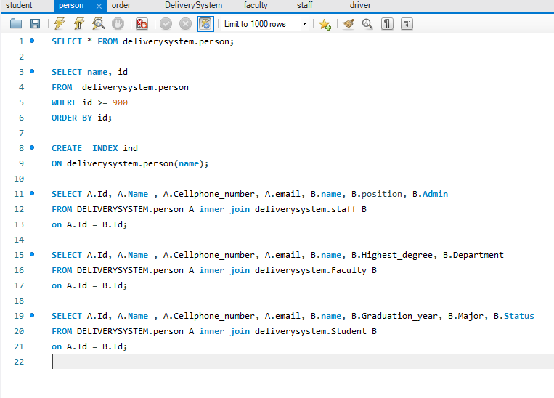
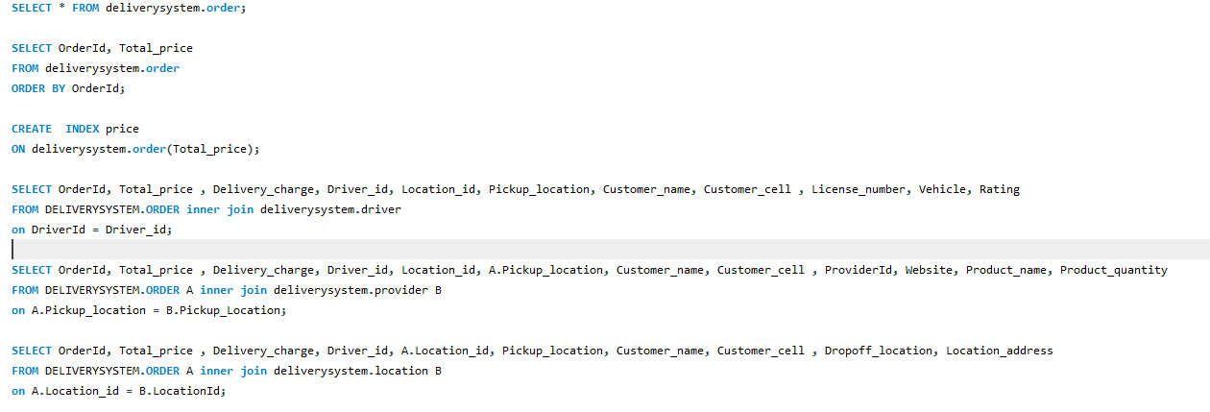
Queries (Index)
In the below query, both price and name is an index and is used as such for query optimization

